Slide 1

Sand Art
Matrix flip and rotation

Slide 2
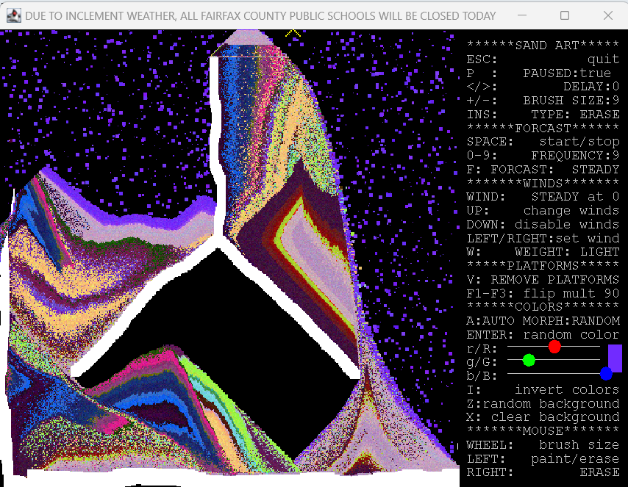
Sand Art – matrix rotation
The ability to flip the canvas and allow the sand to drop results in entropy that can mix the colors in interesting ways.
3 methods are to be defined to flip the canvas 90-degrees to the left and right and to flip the canvas upside down.
F1: flip left 90-degrees
F2: flip upside-down
F3: flip right 90-degrees

Slide 3
//pre: m is a square 2-D array (m.length==m[0].length). //post: flips the array upside down. public static void flipUpsideDown(Object[][]m) { } //pre: m is a square 2-D array (m.length==m[0].length) //post: rotates the array 90 degrees to the left public static void rotateLeft(Object[][] m) { } //pre: m is a square 2-D array (m.length==m[0].length) //post: rotates the array 90 degrees to the right public static void rotateRight(Object[][] m) { }
Each method will alter the contents of the array m that is sent, rather than returning a new array of Objets.

Slide 4
Consider how to flip a small array of simple elements:
Flipping upside down: easy
0 1 2 0 1 2
0 A B C 0 G H I
1 D E F 1 D E F
2 G H I 2 A B C
A helper method that can swap the elements of a matrix can be useful here:
Swap the rows until you reach the half-way point or the middle row.

Slide 5
Consider how to flip a small array of simple elements:
Flipping upside down: easy
0 1 2 0 1 2
0 A B C 0 G H I
1 D E F 1 D E F
2 G H I 2 A B C
A helper method that can swap the elements of a matrix can be useful here:
Swap the rows until you reach the half-way point or the middle row.
//pre: r1, c1, r2 and c2 are valid indexes of the array m
//post: m[r1][c1] and m[r2][c2] will swap values
private static void swap(Object[][]m, int r1, int c1, int r2, int c2)

Slide 6
Consider how to flip a small array of simple elements:
Flipping right 90-degrees: look for the pattern
0 1 2 0 1 2
0 A B C 0 G D A
1 D E F 1 H E B
2 G H I 2 I F C
Consider which index an element should get copied into, as opposed to swap with.
orig row orig col flip row flip col
0 0 0 2
0 1 1 2
0 2 2 2
1 0 0 1
1 1 1 1
1 2 2 1
2 0 0 0
2 1 1 0
2 2 2 0

Slide 7
Consider how to flip a small array of simple elements:
Flipping right 90-degrees: look for the pattern
0 1 2 0 1 2
0 A B C 0 G D A
1 D E F 1 H E B
2 G H I 2 I F C
Consider which index an element should get copied into, as opposed to swap with.
orig row orig col flip row flip col
0 0 0 2
0 1 1 2
0 2 2 2
1 0 0 1
1 1 1 1
1 2 2 1
2 0 0 0
2 1 1 0
2 2 2 0
Be careful:
Assigning the identifier of one 2-D array to another will only copy over the memory address:
Either carefully hyper-swap within the array or copy into a temp array and then copy elements from temp back into the original.

